Slide 1

COIT11241 – Cyber Security Technologies
Assessment 2 – Wk7 CTI
James Ira Arellano (12161580)

Slide 2
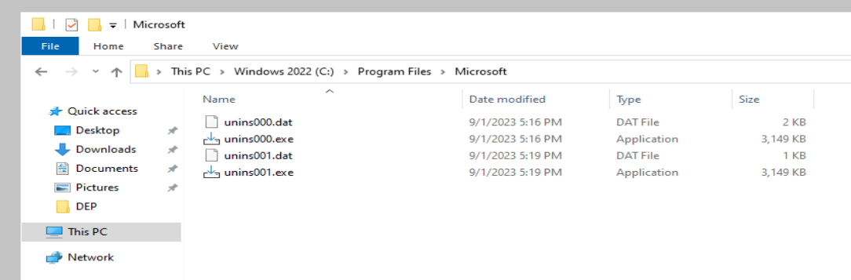
Installing prerequisite software onto DC VM
Both programs “office_2019.exe” and “excel_2010.exe” have been installed in the DC VM for vulnerability checking purposes.
Installation is confirmed by checking the installation path of these programs.

Slide 3
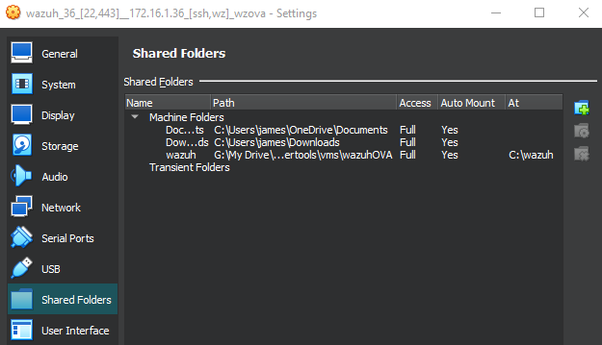
Setting up a shared folder in Wazuh
It is recommended to setup a shared folder within Wazuh to easily move across files from VM to host or vice versa. This is done through VirtualBox Manager and I have mounted both the Downloads and Documents folder of the host for Wazuh.

Slide 4

Search the system for vulnerabilities without Wazuh
Several tools can be used to conduct vulnerability scans. These include Nessus, Nikto, Legion, Nmap and Wafw00f.

Slide 5
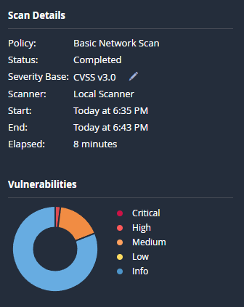
Vulnerability Scan: Nessus (DC)
Using Nessus, a basic network scan was conducted on the DC VM (172.16.1.50) and a report was generated for it, this is appended on to the GitHub repository for viewing.
https://github.com/AikyanP/COIT11241---WK7-CTI/blob/main/DC_JamesArellano_e9m45e.pdf

Slide 6
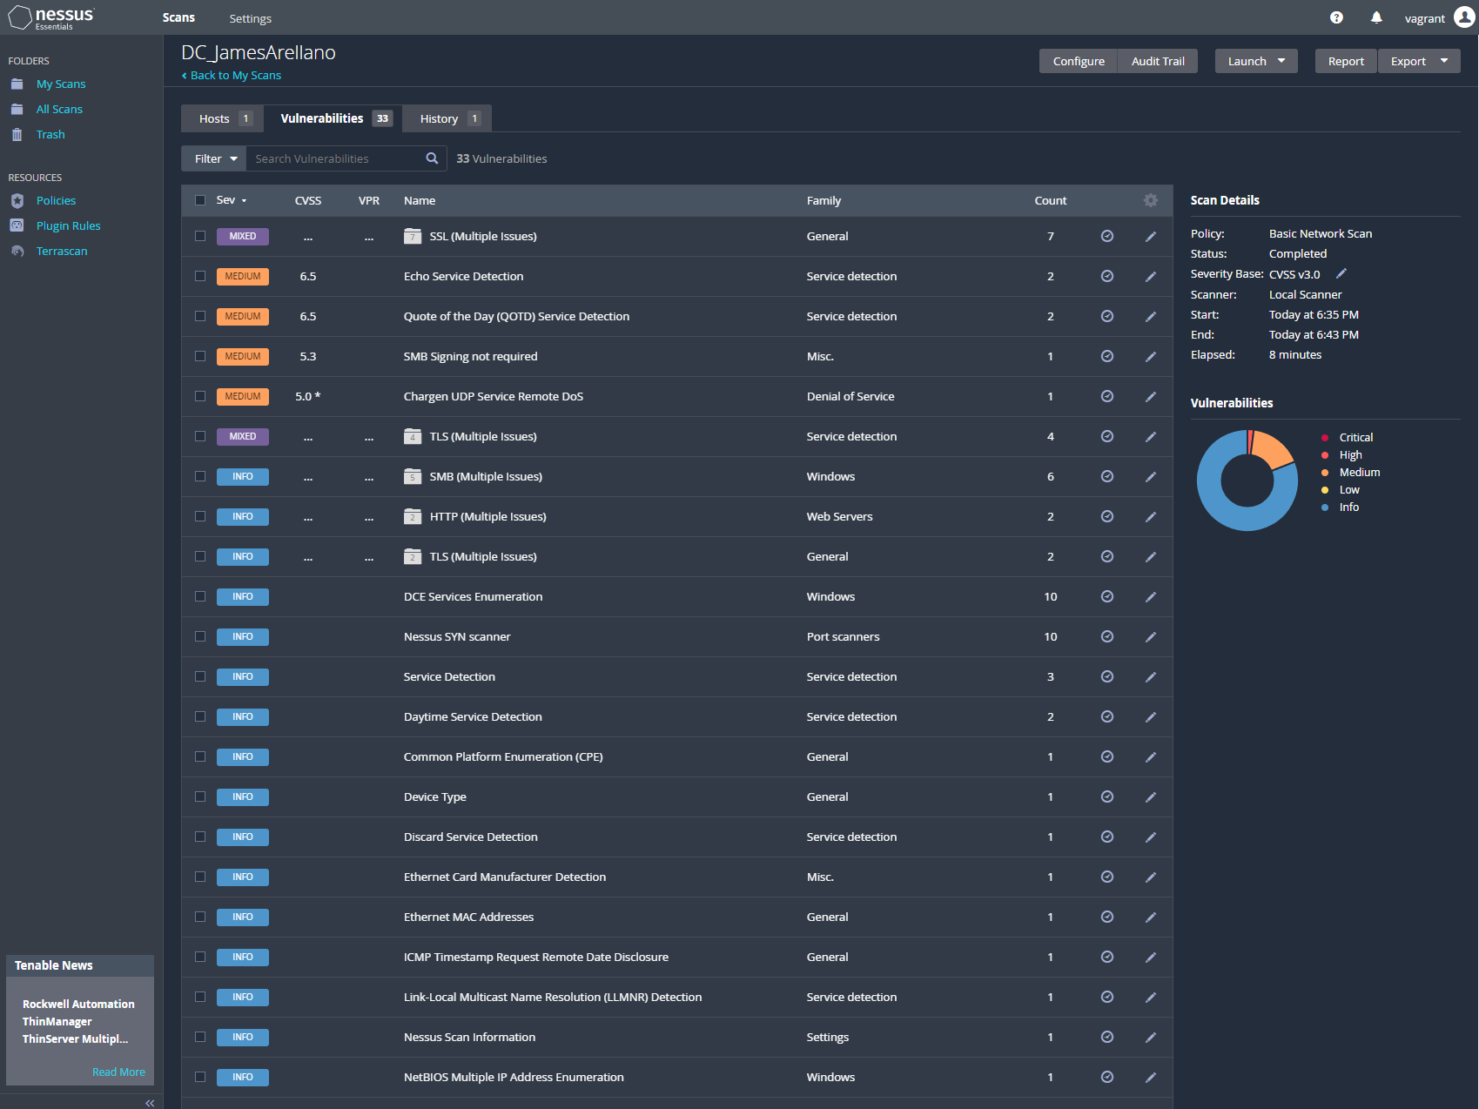
Vulnerability Scan: Nessus (DC)
An example screenshot of the Nessus utility in the browser displaying the vulnerabilities of the DC VM in order of severity. Refer to the previous slide for the GitHub link for the full report.

Slide 7
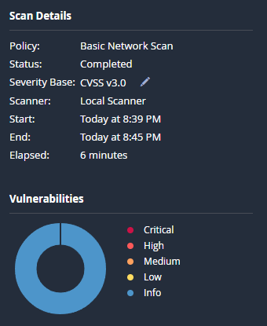
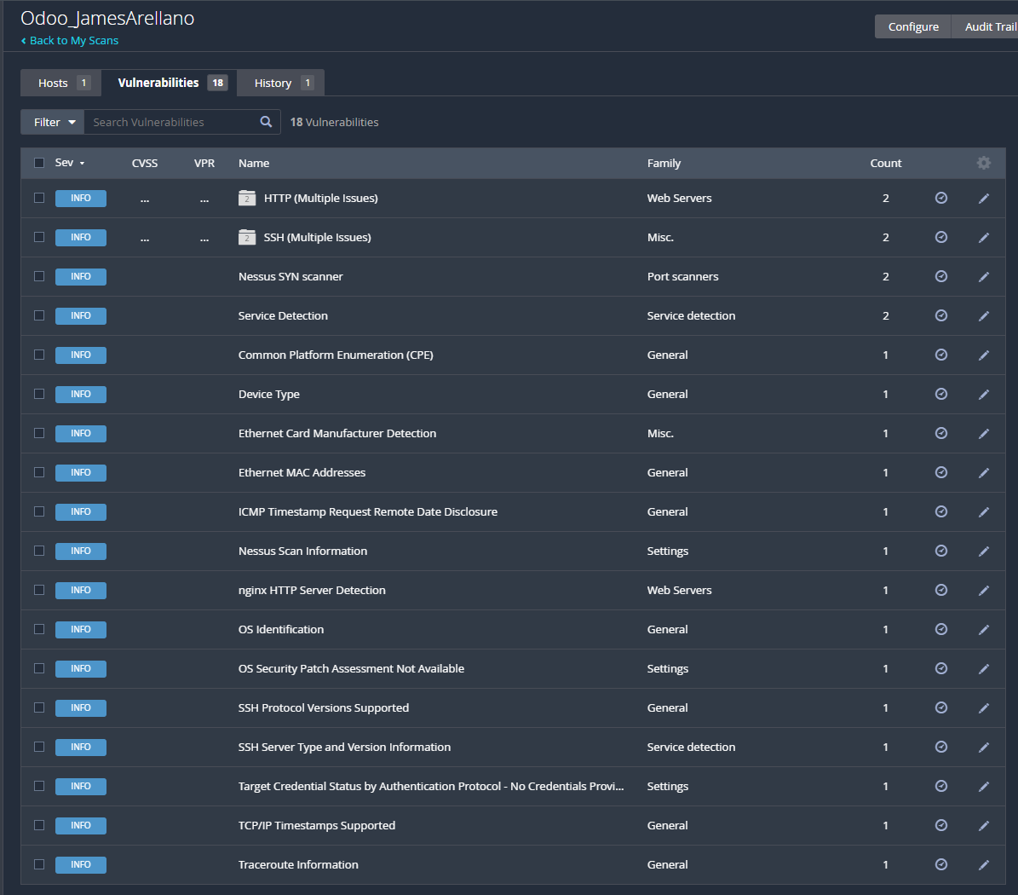
Vulnerability Scan: Nessus (Odoo)
Here is the main scan details of the Odoo VM. A list of the vulnerabilities present is also shown. The full report can be accessed in the GitHub repository:
https://github.com/AikyanP/COIT11241---WK7-CTI/blob/main/Odoo_JamesArellano_j0q5jh.pdf

Slide 8
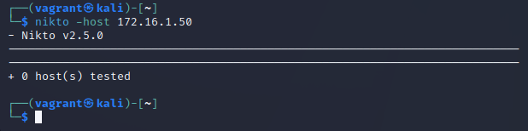
Vulnerability Scan: Nikto (DC)
Currently, Nikto is not picking up the DC VM so it has not been properly tested so far.

Slide 9
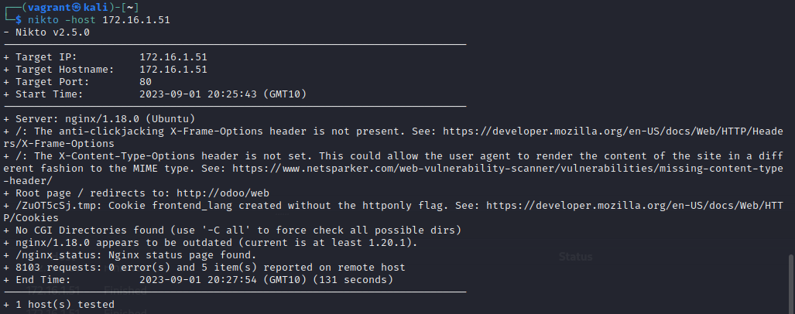
Vulnerability Scan: Nikto (Odoo)
Here is the vulnerability scan results of using Nikto to track vulnerabilities of the Odoo VM.

Slide 10
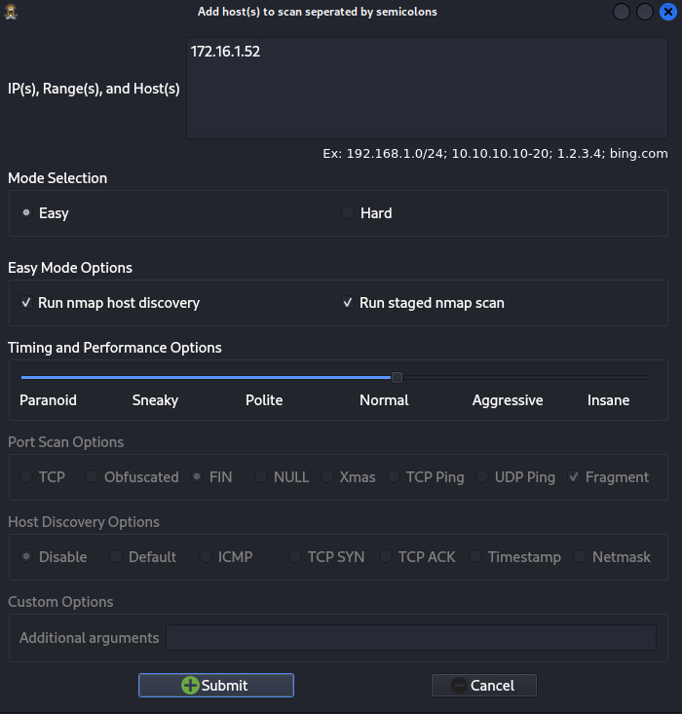
Vulnerability Scan: Legion (DC)
Legion(root) is an app within the Kali VM that is used to scan and identify vulnerabilities of its target.

Slide 11
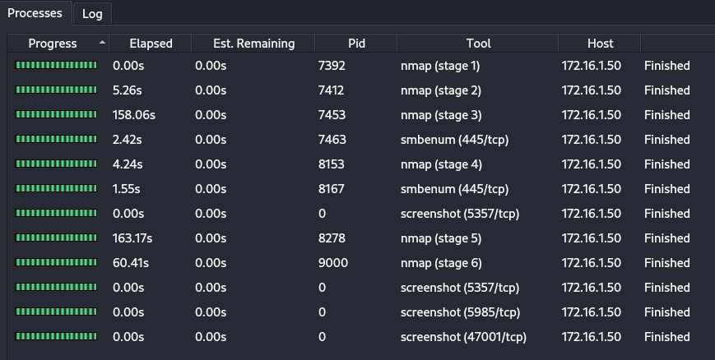
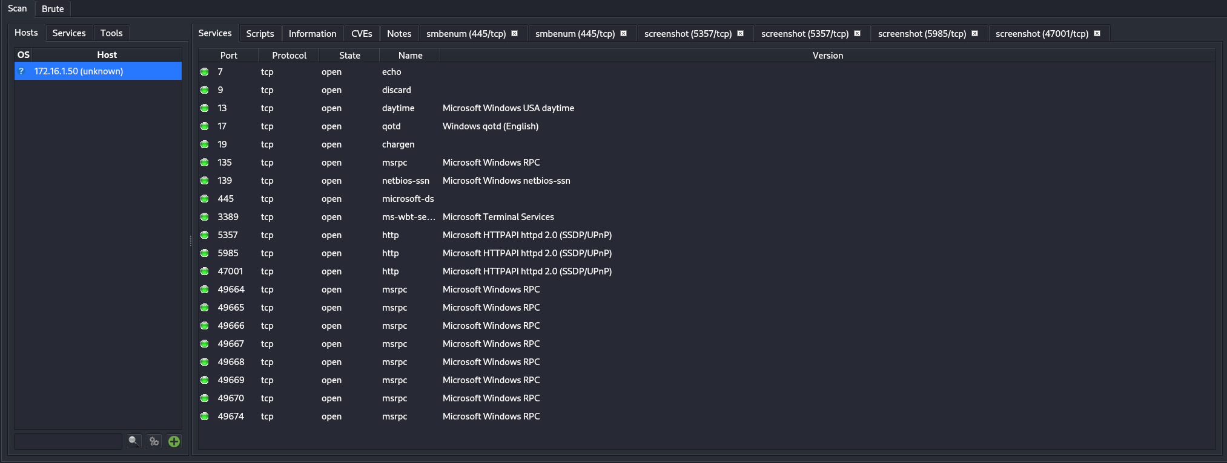
Vulnerability Scan: Legion (DC)
Numerous screenshots will be displayed to show the contents of the normal level Legion scan.

Slide 12
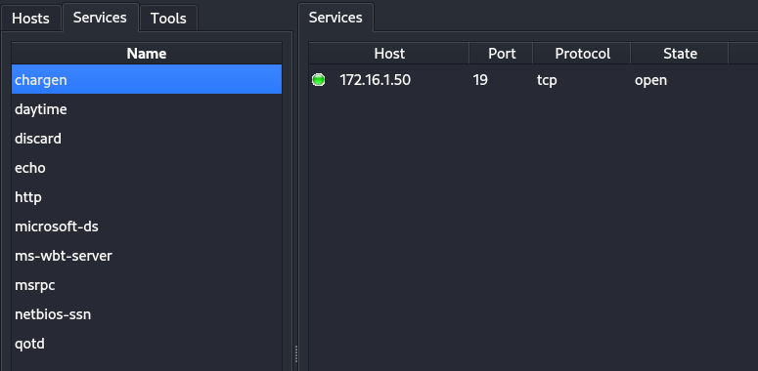
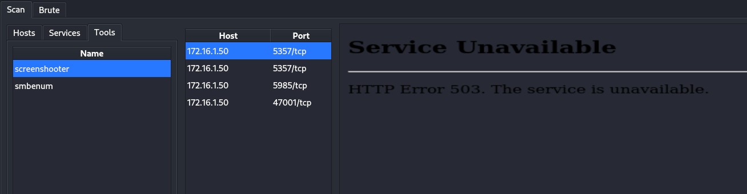
Vulnerability Scan: Legion (DC)
Here are further images of the legion scan

Slide 13
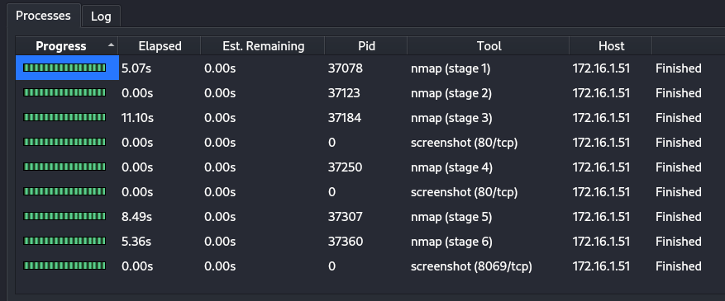
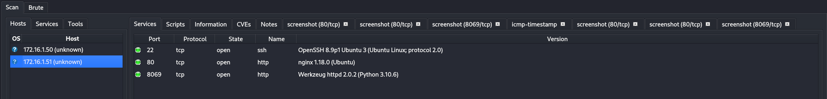
Vulnerability Scan: Legion (Odoo)
Here are screenshots of the Legion scan on the Odoo (172.16.1.51) VM. It also uses the same Normal scan setting as the DC VM.

Slide 14
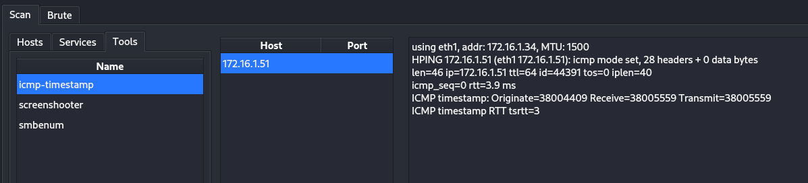
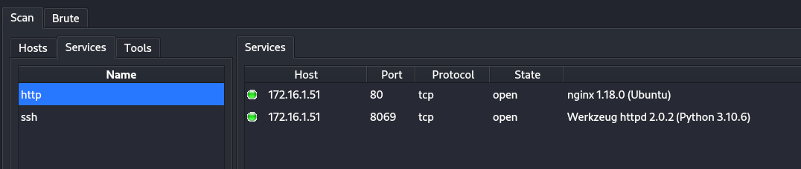
Vulnerability Scan: Legion (Odoo)
Here are further screenshots of the Legion scan of the Odoo VM.

Slide 15
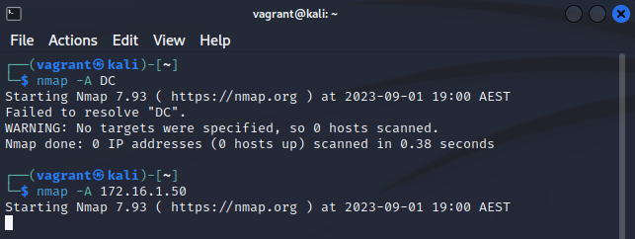
Vulnerability Scan: Nmap (DC)
Nmap is now used within the Kali VM to search for vulnerabilities within the DC machine. It can be easier input the target IP of the scan as shown in the 2nd attempt as to using the VM name.

Slide 16
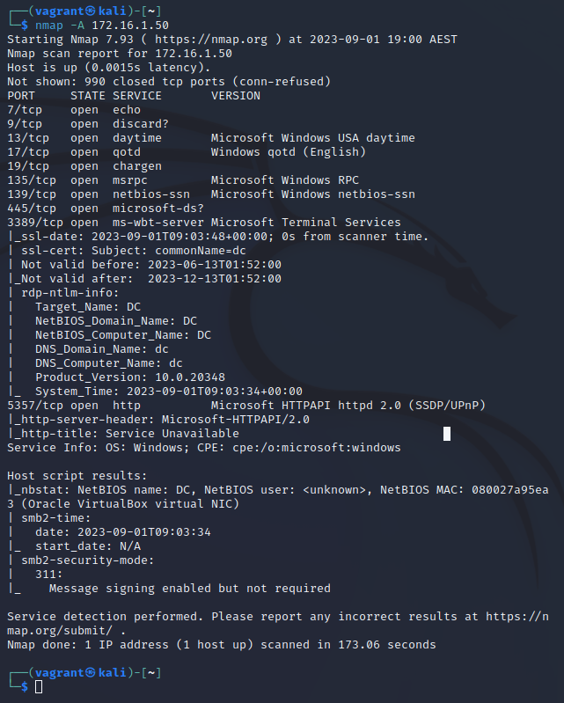
Vulnerability Scan: Nmap Results (DC)
The result of the Nmap scan are as follows.
It can be seen that both Nmap and Legion primarily show services that have open ports which can highlight points of concern.

Slide 17
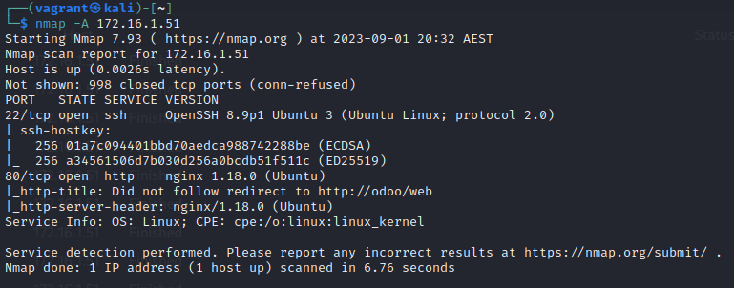
Vulnerability Scan: Nmap Results (Odoo)
The same command was used on the Odoo machine but with a different target of 172.16.1.51 was used to scan the Odoo VM for vulnerabilities.
“nmap –A 172.16.1.51”

Slide 18
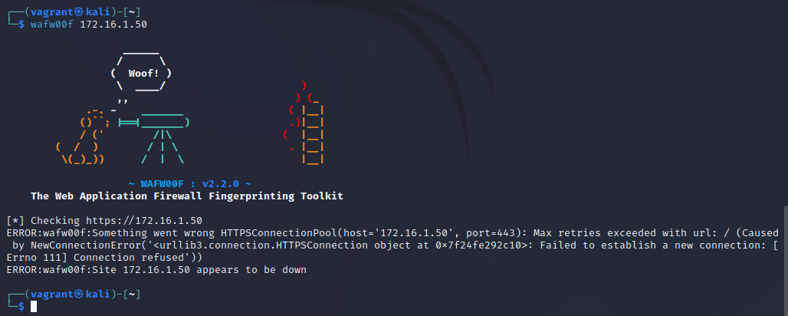
Vulnerability Scan: Wafw00f (DC)
Similar to Nikto, Wafw00f currently cannot scan the DC VM for vulnerabilities.

Slide 19
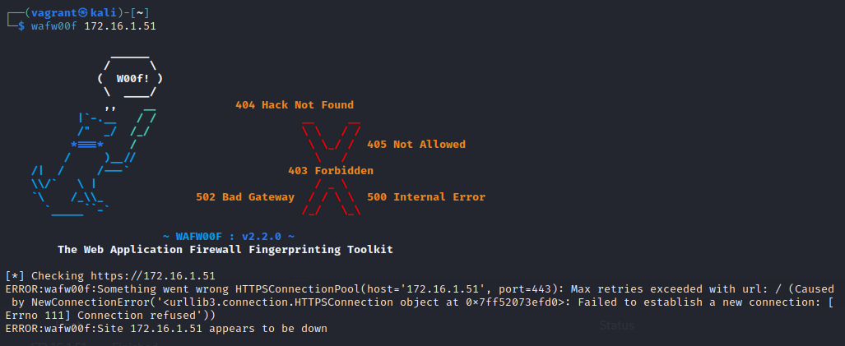
Vulnerability Scan: Wafw00f (Odoo)
Similar to Nikto, Wafw00f currently cannot scan the odoo VM for vulnerabilities.

Slide 20
Using Wazuh to search for vulnerabilities
Login to the Wazuh VM using the first set of credentials to login, this is followed up by a “sudo cp” command which will ask for credentials once more. Once elevated, a command can be used to transfer a file called “cpe_helper.json” from Wazuh into the Host.
“sudo cp /var/ossec/queue/vulnerabilities/dictionaries/cpe_helper.json /media/sf_host
In our case of setting up a shared folder, instead of “sf_host”, the following shared folders of Documents and Downloads of the host can be used.
Replace sf_host with sf_Documents
Or, replace sf_host with sf_Downloads

Slide 21
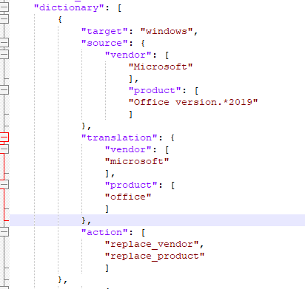
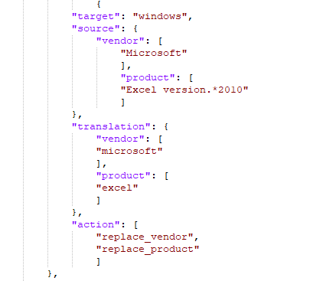
CPE_Helper file additions
Both the Office 2019 and Excel 2010 applications have been manually added onto cpe_helper.json through a provided template. Source vendor and product names were located through the Wazuh Inventory Data and Translation from: https://nvd.nist.gov/products/cpe/search

Slide 22
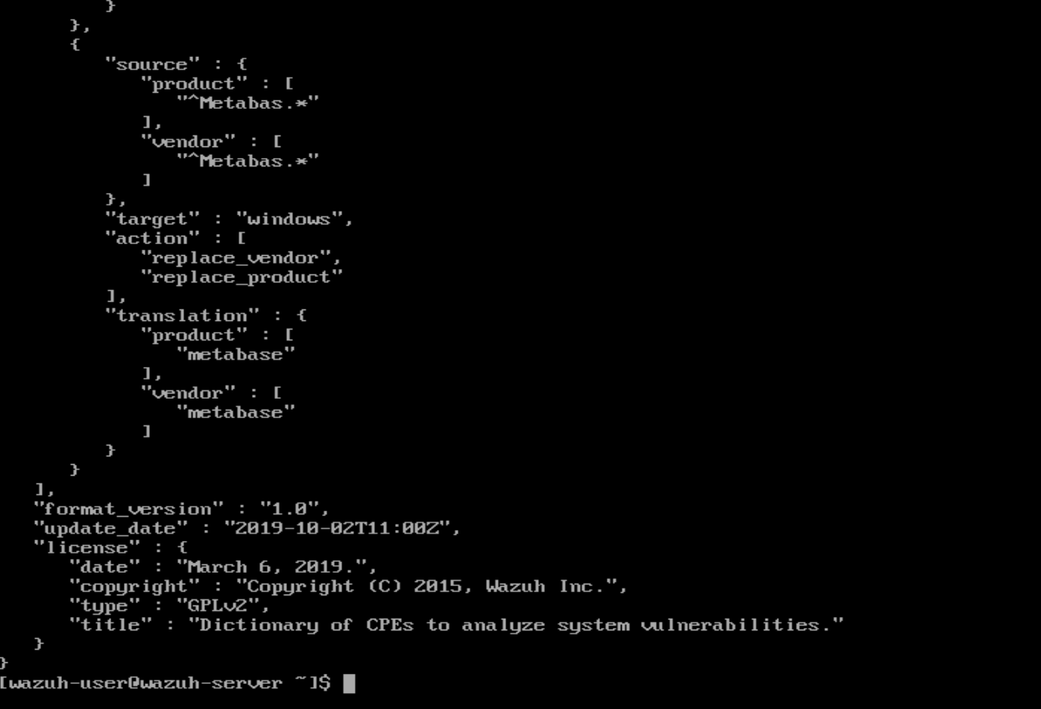
File Checking CPE_Helper
The file is now sent back to Wazuh through the command:
“sudo cp /media/sf_Downloads/cpe_helper.json /var/ossec/queue/vulnerabilities/dictionaries”
After sending the file back to Wazuh, JSON syntax errors were checked for using:
“sudo ~wazuh-user/checkCpeHelper.sh”

Slide 23
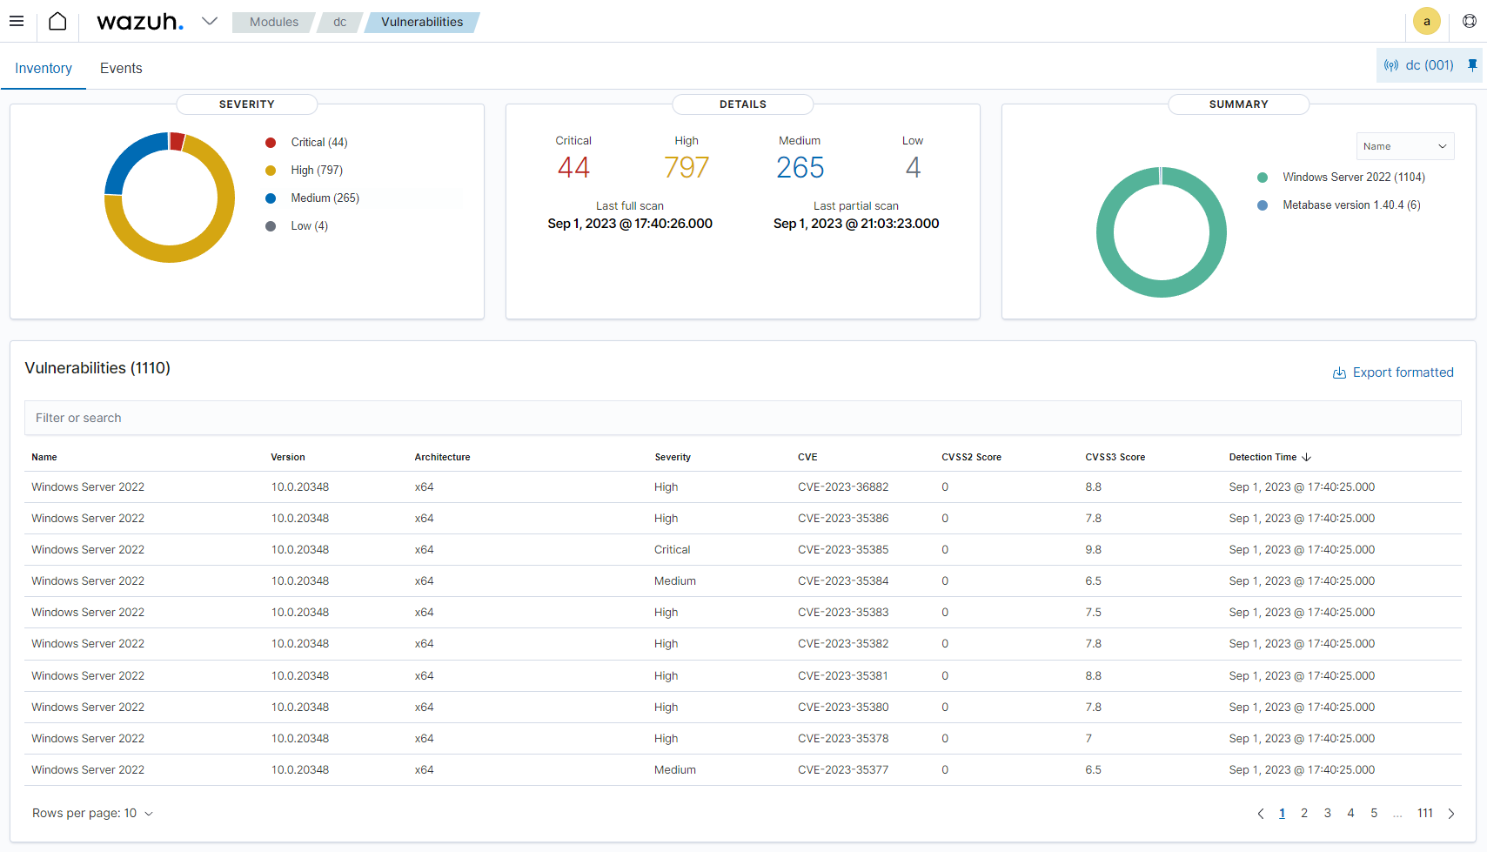
Wazuh Vulnerability Scan
This new scan is triggered by restarting Wazuh. New list of vulnerabilities should then be found.

Slide 24
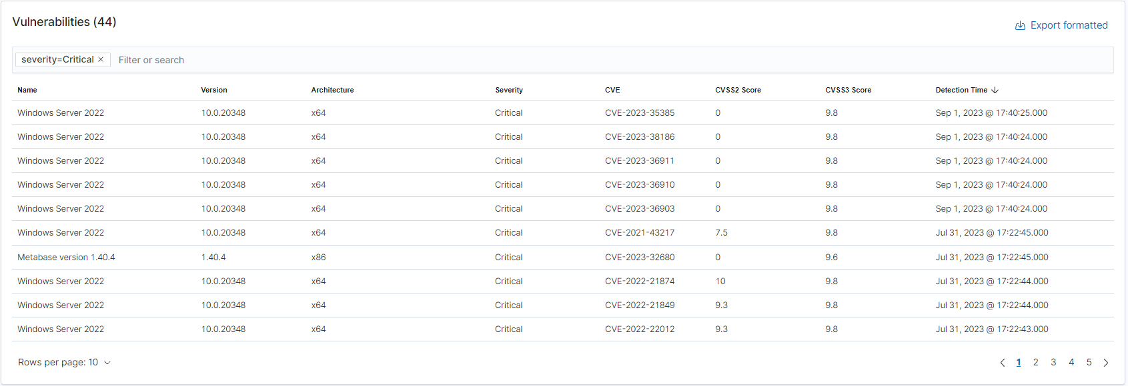
Wazuh Vulnerability Scan Results
As Wazuh shows, there are currently critical vulnerabilities in the DC machine. These are outlined with their respective CVE’s to direct attention to what vulnerabilities be addressed first. Here are a few to demonstrate.
A full report of all discovered vulnerabilities are available in a CSV spreadsheet on the GitHub Repository: https://github.com/AikyanP/COIT11241---WK7-CTI/blob/main/vulnerabilities.csv

Slide 25
Prioritising Vulnerabilities & BlackCat Exploitation
BlackCat is a ransomware program that is operated as a service. It is regarded as the most threatening malware in 2021 and 2022. BlackCat operates via two stages.
Its first stage involves brute forcing and illicitly purchasing credentials. These vulnerabilities are also published as CVEs (e.g. CVE-2019-7481).
The second stage involves establishing reverse SSH tunnels which allows attacks to be fully command line driven. This can then be used to attack Active Directory user and administrator accounts as well as access and encryption of sensitive files.
~Blackberry. (N.D.). BlackCatMalware (AKA ALPHV)

Slide 26
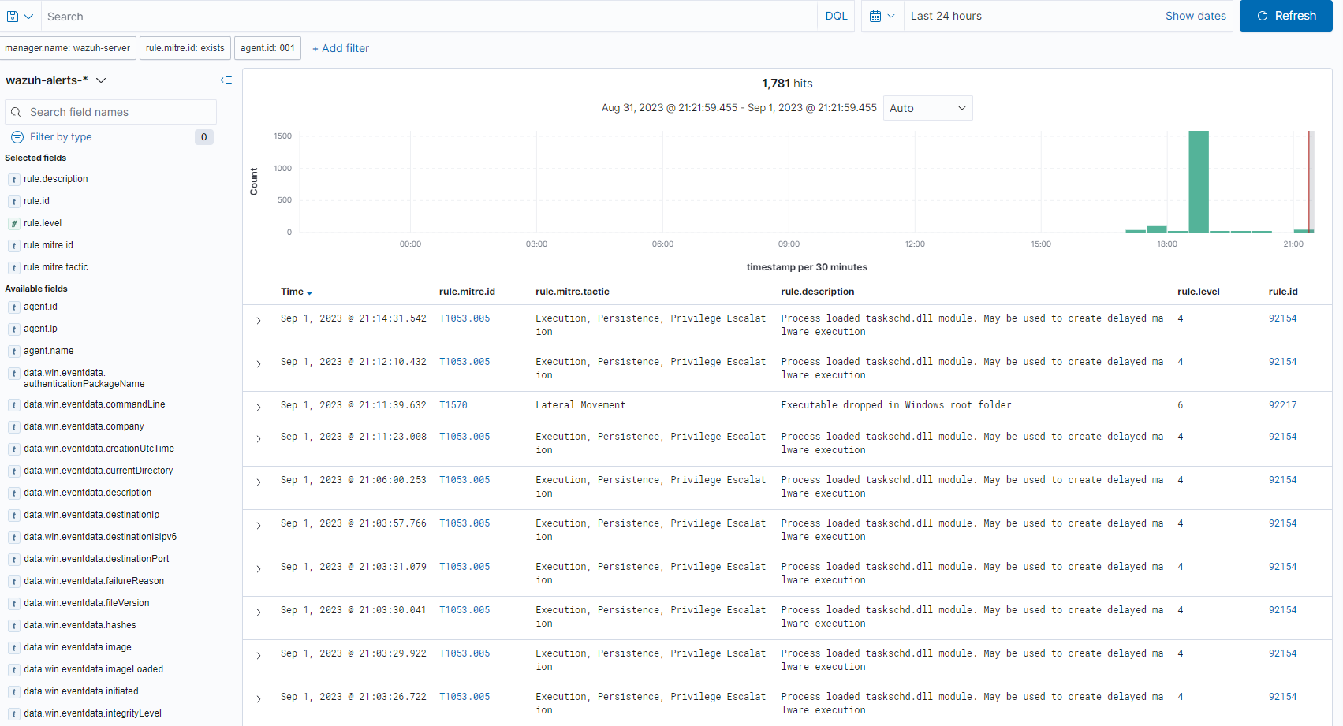
ATT&CK TTPs (MITRE ATT&CK Framework)
Wazuh shows that the DC machine has vulnerabilities where BlackCat can use as several techniques to attack.
T1087 utilises net use commands to identify domain users.
T1570 can allow BlackCat to replicate across connected serves via psexec.
T1059 can execute commands on a compromised network with cmd.exe.
~MITRE ATT&CK (2023). BlackCat
Example photo of Wazuh MITRE ATT&CK Dashboard

Slide 27
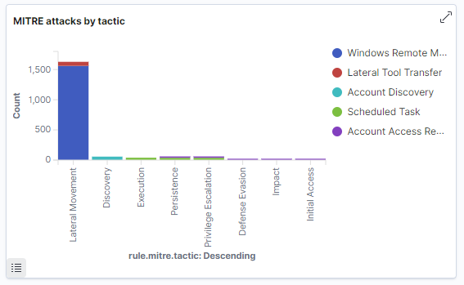
CAPEC Attack Patterns
CAPECs relevant based on the ATT&CK TTPs shown in Wazuh Dashboard are as follows:
CAPEC-555 Remote Services – enormous amount of MITRE attacks through windows remote management can occur in the DC VM.
CAPEC-643 Identify Shared Files/Directories on System – there are a decent amount of attacks that involve lateral tool transfer in DC.
CAPEC-575 Account Footprinting – Similarly to lateral tool transfer, there are a decent amount of MITRE attacks that involve account discovery.

Slide 28
Common Weakness Enumeration (CWEs)
Related CWEs in the DC machine based on the Wazuh MITRE ATT&CK and their relevant CAPECs.
CWE-522 – Insufficiently Protected Credentials
CWE-308 – Use of Single-factor Authentication
CWE-309 – Use of Password System for Primary Authentication
CWE-267 – Privilege Defined With Unsafe Actions
CWE-200 – Exposure of Sensitive Information to an Unauthorised Actor

Slide 29

Monto Caravan and Cabin Park Rationale
Based on the presented MITRE ATT&CK techniques and its related CAPECs and CWEs, as well as information present within Wazuh’s Dashboards for Threat Detection and Response. The most important vulnerabilities to fix within the system were as previously mentioned. These are mainly exploits and weaknesses that BlackCat utilise, addressing those vulnerabilities will likely reduce the effect or impact an attack would have on the Monto Caravan and Cabin Park.

Slide 30
Sources
GitHub Repository:
https://github.com/AikyanP/COIT11241---WK7-CTI

Slide 31
References
BlackBerry. (N.D.). BlackCat Malware (AKA ALPHV). Retrieved from https://www.blackberry.com/us/en/solutions/endpoint-security/ransomware-protection/blackcat
CAPEC. (2023). CAPEC-555: Remote Services with Stolen Credentials. Retrieved from https://capec.mitre.org/data/definitions/555.html
CAPEC. (2023). CAPEC-575: Account Footprinting. Retrieved from https://capec.mitre.org/data/definitions/575.html
CAPEC. (2023). CAPEC-643: Identify Shared Files/Directories on System. Retrieved from https://capec.mitre.org/data/definitions/643.html
MITRE ATT&CK. (2023). BlackCat. Retrieved from https://attack.mitre.org/software/S1068/

Slide 32
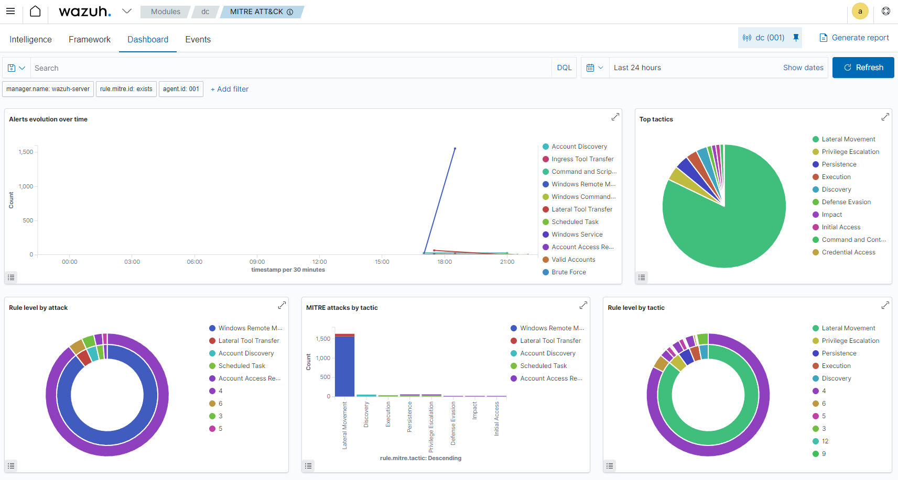
Appendix: Wazuh Dashboards

Slide 33
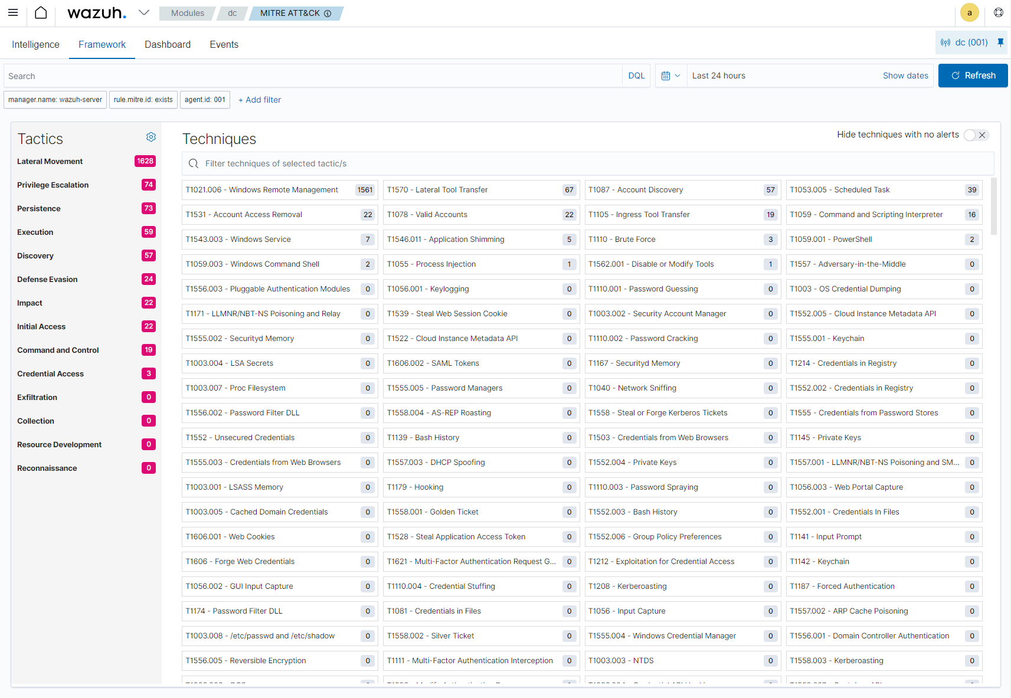
Appendix: Wazuh Dashboards

Slide 34
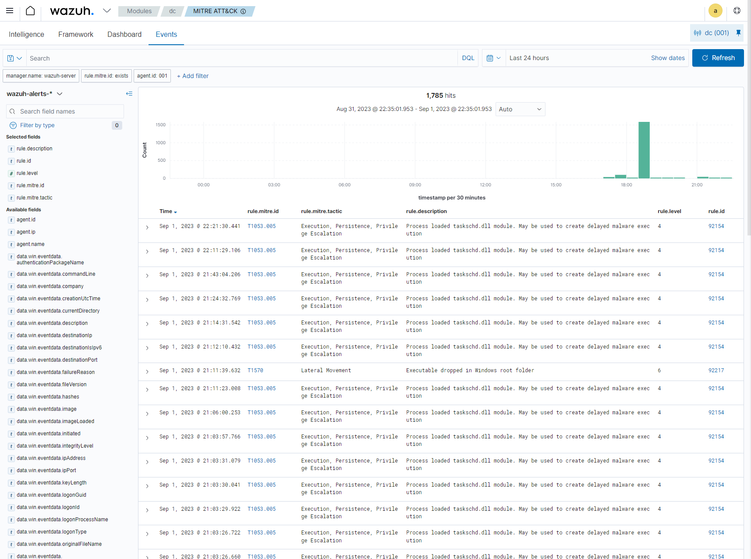
Appendix: Wazuh Dashboards

